Slide 1
Front End Informal Meeting With Swiss Light Source
Front End Informal Meeting With Swiss Light Source
Front End Informal Meeting With Swiss Light Source
Prepared by Xia Liu

Slide 2
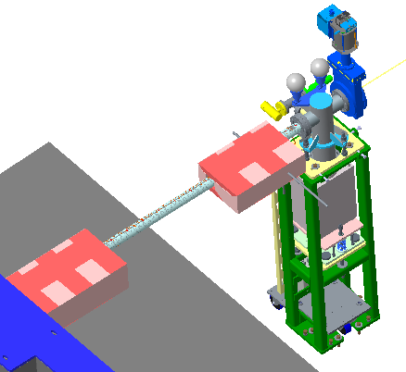
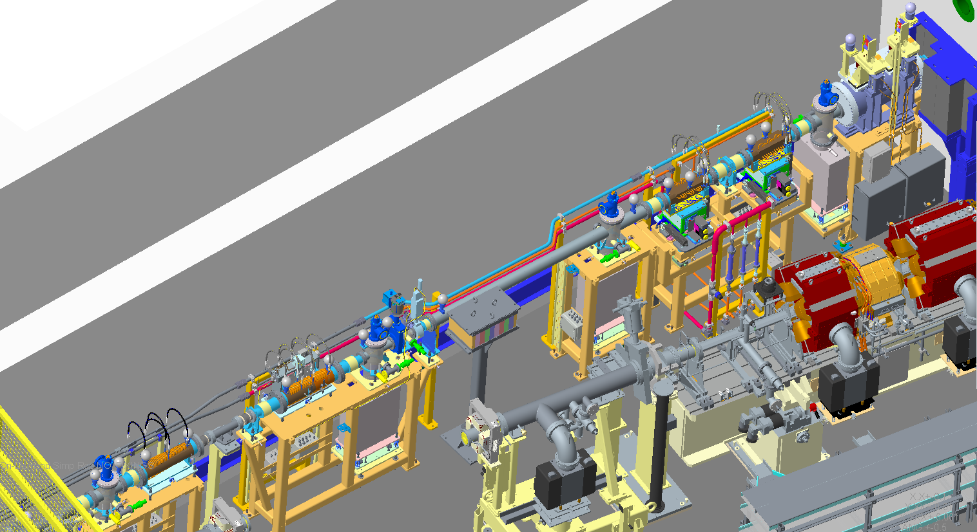
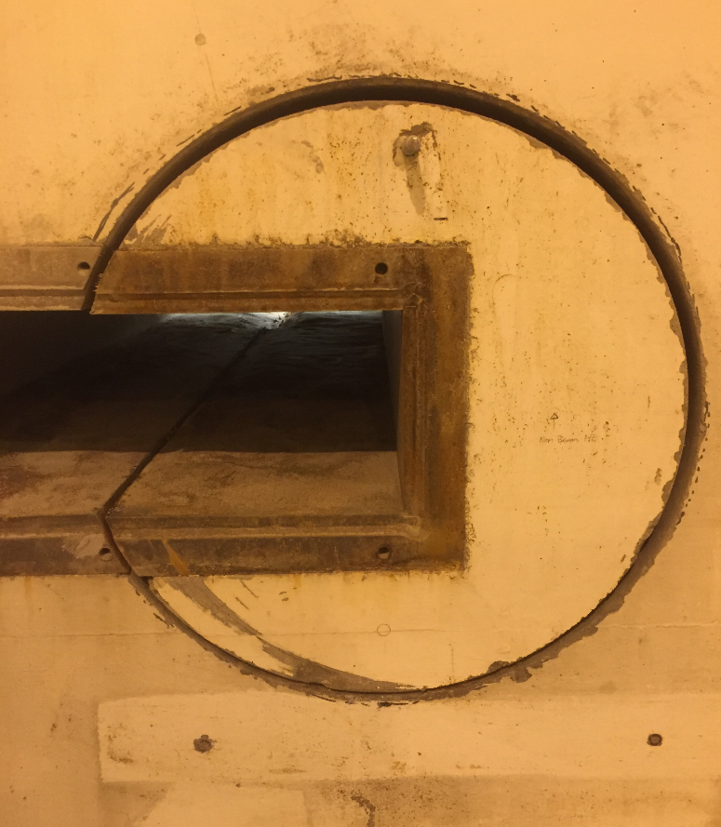
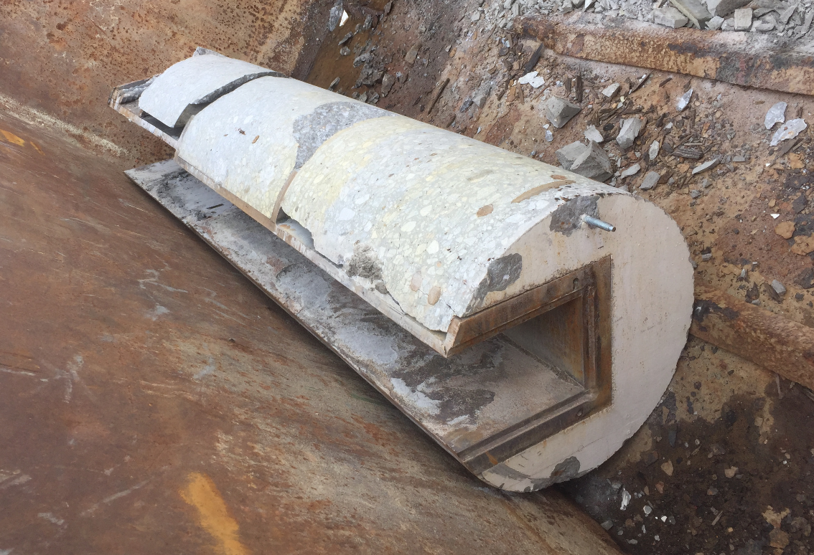
Insertion Device Front End
Twin Port Shutter Module
Lead Wall
Wall Pipe
Steel Penetration
OH Module
Front End K11 Dual Imaging and Diffraction Beamline
Slits
Module
Stand Alone Lead
Fast Valve
Absorber
First Aperture
Module Zero

Slide 3
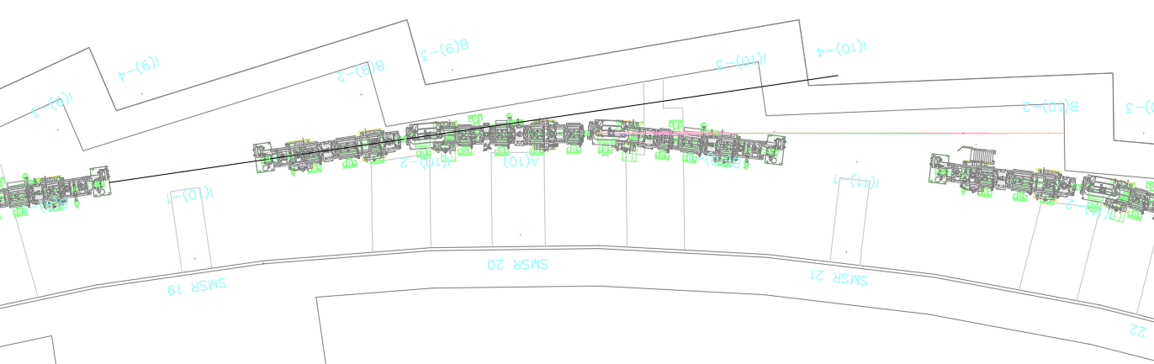
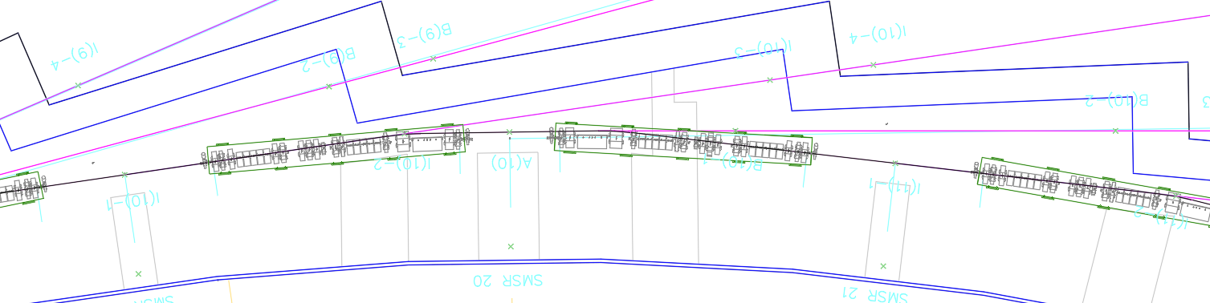
Diamond-I and Diamond-II Layout
Diamond-I Layout
ID Beamline
BM Beamline
D1
D2
Diamond-II Layout
D-I ID Beamline
D-II
‘K’ Beamline
New ‘K’ mid straight

Slide 4
‘I’ Front Ends
‘ I’ Front Ends receiving light from IDs located in main straight
Source | Location |  | Front End Compatibility with D-II
 |  |  | Absorber |  | Aperture & Slits | Beam Splitter
Single Insertion Device (no chicanes) | I05, I06, I08, I10, K11, I16, I21, I23
 | I12 |  | Yes |  | Yes
 | I15 |  | Yes |  | Yes | No
 | K02, I14 |  | Yes
 | I18, I22
Single Canted Insertion Device | I02, I03, I07, I24 |  | Yes
 | I11 |  | Yes |  | Yes | NA
 | I19
Two Canted Insertion Devices | I04 & J04 |  | Yes
 | I13-1 & I13-2, I09-1 & I09-2
 | I20-1 & I20-2
CPMU ID decision before D-II CDR |  | SCU upgrade in 2020 |  | Approved ID upgrade before D-II
New Module required to connect Front Ends to the ring.
Thermal analyses to confirm components power handling are in progress. This has been completed for Front End I11.
Front End I09 and I13 will need to be realigned with new offset.
J04 and I20-2 will be relocated so that they receive light from ‘K’ straight
All existing ‘ I’ Front Ends will need to carry out Gas Bremsstrahlung ray tracing following Health Physics guidance to confirm adequate shielding
A new flagship Front End at I17.

Slide 5
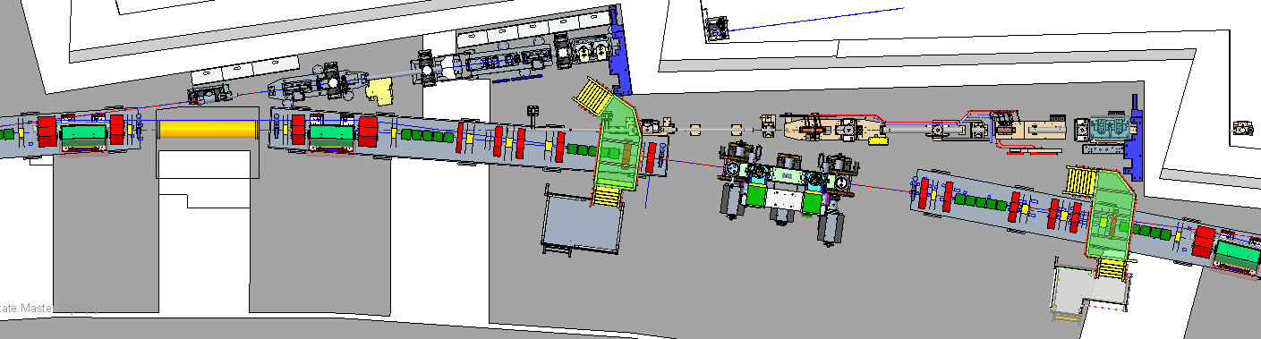
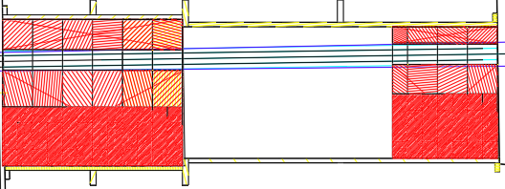
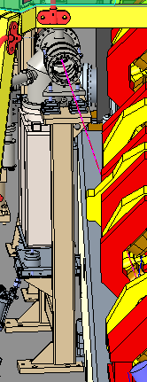
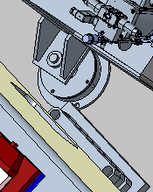
‘I’ Front Ends
Front End I02
Front End K02
SM
MS
K02 HPMU Space Envelope
SM
I03 CPMU
Front End in the cell model for all 24 ‘I’ Front Ends are nearly completed.
There are good clearances overall with adjacent equipment although some minor interferences locally have been observed.
Insertion devices installed at new mid-straight will need to follow the defined space envelope.
10 Front Ends will require detailed assessment of the wall penetration shielding because of lateral offset of the line.
All Insertion Device Front End access ladders can be reused. Some of the ‘K’ Front Ends will need new ladders.
The existing PSS search routes remain unchanged.

Slide 6
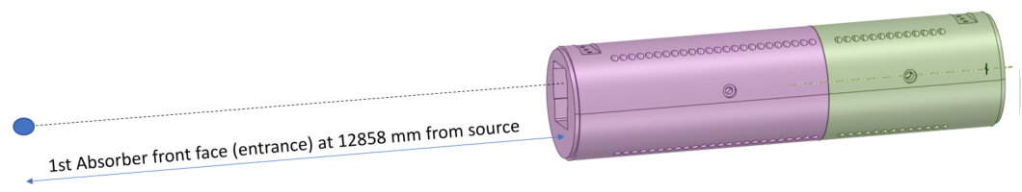
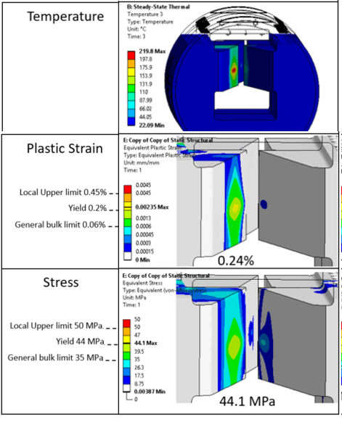
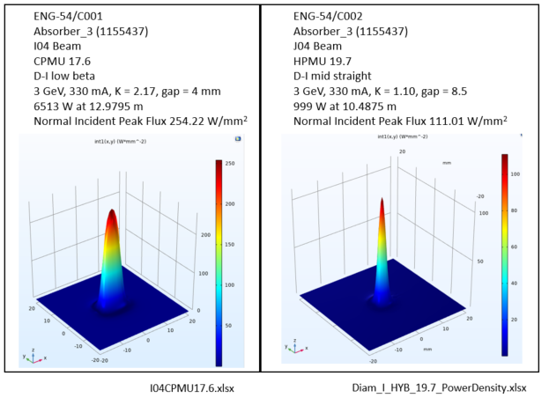
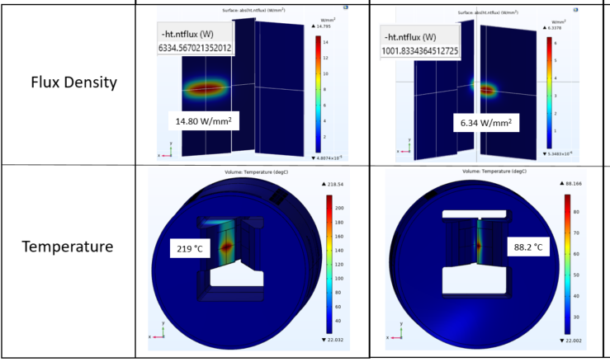
Front End Absorber FEA
ANSYS
COMSOL

Slide 7
‘K’ Front Ends
‘K’ Front Ends receiving light from mid straights
Front End K02 and K11 will need realignment.
Front End K24 will use D4 (DQ downstream of mid-straight) as the source and will require repositioning.
Two new flagship ‘K’ Front Ends at K04 and K14.
New RF cavities at K05 and K06.
Front End K07 has revised CDR decision. Two branches in the front end are staying together. The renamed ‘I’ branch will take light from an insertion device in mid-straight. The ‘D’ branch will take light from a dipole. New front end will be needed.
Front Ends K18, 22 & 23 will require potential significant repositioning or replacement for straight-ahead or canted geometry.
K16, K21 & K18 could potentially use an ‘I’ Front End design
Diamond-I BM Front Ends

Slide 8
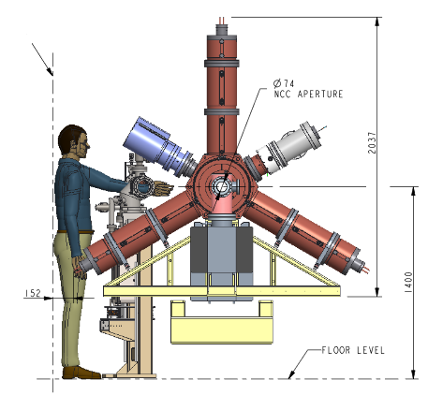
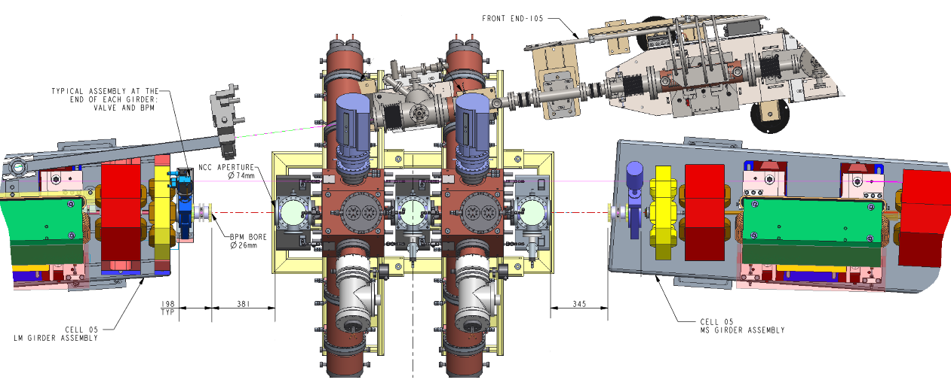
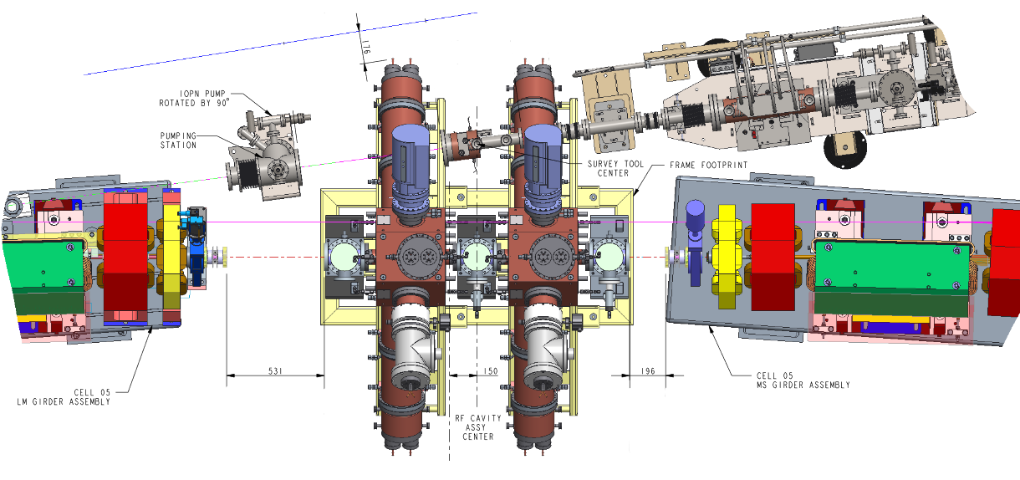
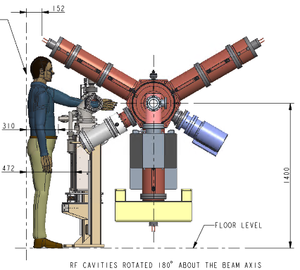
K05 & K06 Front Ends
I05 & I06 FE 1st Module has a major clash with RF Cavities
Ratchet Wall
Work In Progress
PSS search route
LM
MS
Separate and relocate the 1st Module
Ratchet Wall
Ratchet Wall
Can be integrated into Module Zero

Slide 9
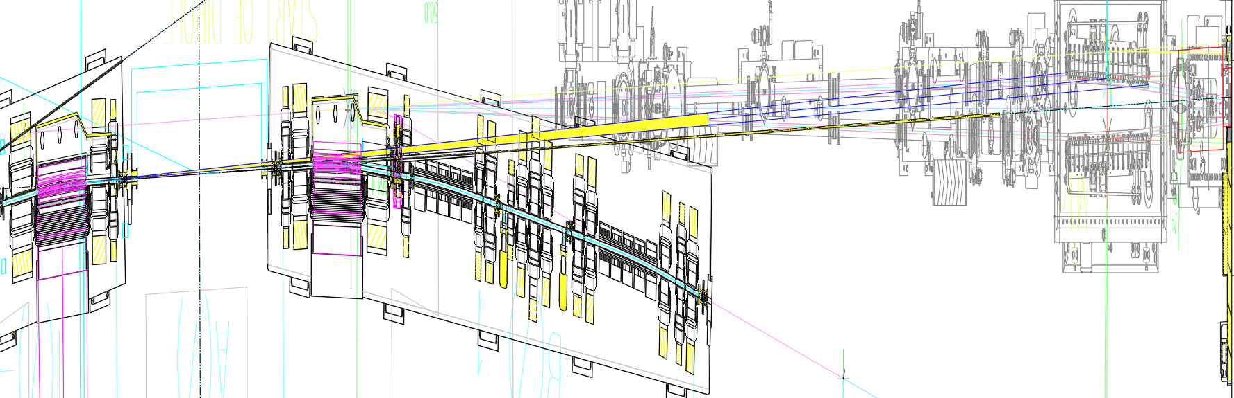
K07 Front End
4mrad fan from US DQ could be extracted and cover the Mirror for Branch B
Proposed US DQ Beam Centre 5.4mrad to K07 ID Beam Axis
B07 Current Beam
K07 ID Beam

Slide 10
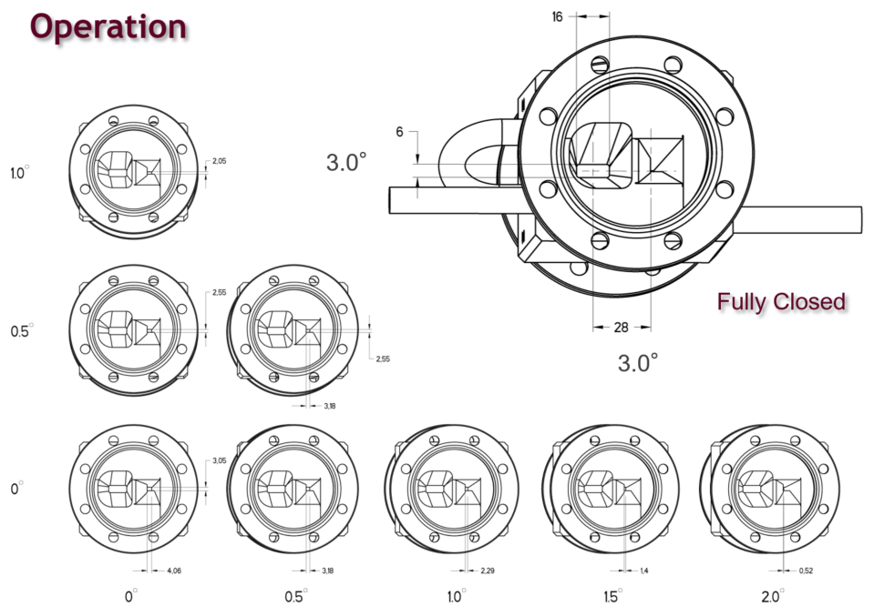
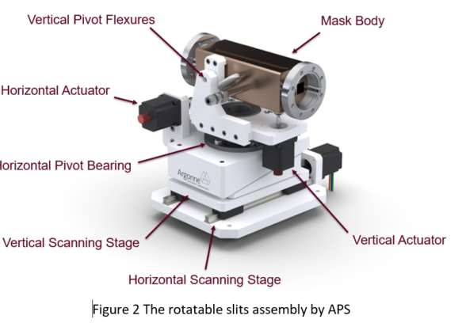
Prototype Slits
Oliver Schmidt / MEDSI 2014

Slide 11
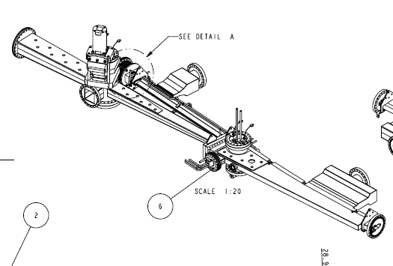
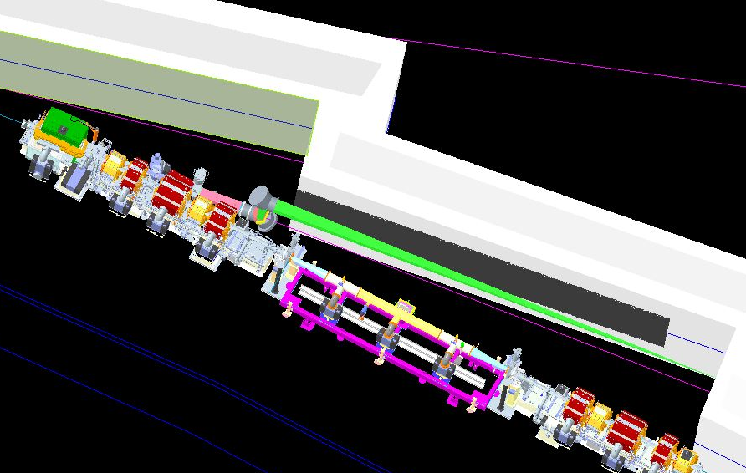
‘K18, 22 & 23’ Front Ends
D-I | D-II | Source
B18 | K18 | Bending Dipole D4 3PW
B22 | K22
B23 | K23
Bespoke Dipole/Crotch vessel for D-I
B22 beamline requires the front end vacuum vessel tapered for accepting SR (ideally 30mrad V and 40mrad H for IR.)
D-II vessel will be restricted in height: 6mm high vessel aperture to pass through magnets for a nominal distance of 10.5m (±0.2-0.3mrad about mid-plane)

Slide 12
Next Step
Front End Design
Front End Manufacture
Start of Dark Period
TDR
DEC. 2021
To mid 2023
Mid 2023
Dec 2025
Identify major components upgrades, feasibility confirmation
Front End slit prototype
3 new flagship front ends – Concept Design
K22 IR

